Slide 1



Amazon Sales Data Analysis Project
Sales Trends, Key Metrics, and Insights
Presented by: Ghate Nikhita Laxmanrao

Slide 2


Project Introduction
Purpose: Analyze Amazon sales data to understand trends and key financial metrics.
Tools Used: Python for ETL and Power BI for data visualization.
Objectives: Uncover month-wise, year-wise, and yearly month-wise sales trends, and evaluate key financial metrics like revenue, cost, and profit.

Slide 3
Project Objectives
Conduct an ETL (Extract-Transform-Load) process to prepare the dataset.
Analyze sales trends based on time (month-wise, year-wise).
Identify and calculate key metrics (e.g., revenue, profit).
Present insights using data visualizations.
Tools and Techniques: Python (ETL), Power BI (visualization).

Slide 4
Data and ETL Process
Data: Amazon sales dataset including order dates, prices, and units sold.
ETL Process:
Extract: Loaded data into Python for cleaning and preparation.
Transform: Handled missing values, formatted dates, and calculated additional metrics (total revenue, cost, profit).
Load: Exported clean data into Power BI for visualization.
Visual: Show a simple diagram illustrating the ETL process.

Slide 5
Key Metrics Overview
Total Revenue: $137,348,768.31
Total Cost: $93,180,569.91
Total Profit: $44,168,198.40
Average Unit Price: $276.76
Average Unit Cost: $191.05
Visual: Show a chart or table with these metrics for clear visualization.

Slide 6
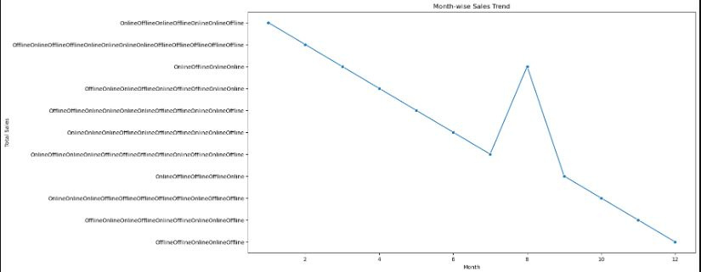
Month-wise Sales Trend
Analysis: Analyzed monthly sales to find high-revenue months.
Key Insight: Peak sales occur in November and December, suggesting a seasonal pattern.
Visual: Bar chart with Order Month on the x-axis and Total Revenue on the y-axis.
05

Slide 7
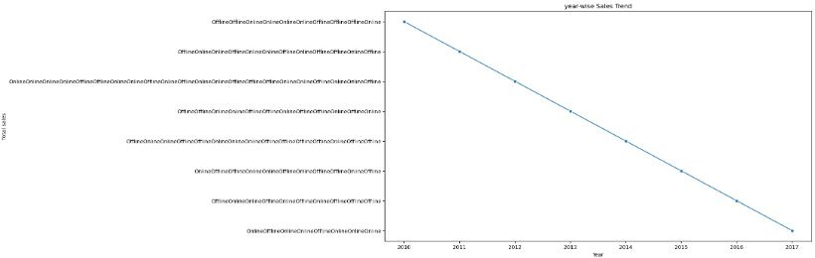
Year-wise Sales Trend
Analysis: Compared year-over-year sales performance.
Key Insight: Consistent revenue growth, with a sharp rise in 2020.
Visual: Bar chart with Order Year on the x-axis and Total Revenue on the y-axis.
05

Slide 8
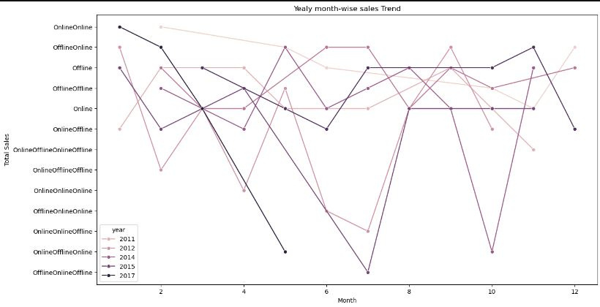
Yearly Month-wise Sales Trend
Analysis: Analyzed the relationship between months and years to identify seasonal trends over multiple years.
Key Insight: Certain months (e.g., November, December) consistently perform well across different years.
Visual: Line chart with Order Month on the x-axis and Total Revenue on the y-axis, with different colors for each year.
05

Slide 9






Insights & Recommendations
Sales Trends: Peak sales occur during the holiday season (Nov-Dec), suggesting a need to increase inventory during these months.
Revenue Growth: A steady increase in revenue year-on-year, with 2020 being a particularly strong year.
Recommendations: Optimize promotional campaigns around the holiday season and improve pricing strategies based on cost-profit analysis.
Visual: Use a summary infographic or icons to display key insights.

Slide 10
Conclusion & Next Steps
Summary: This project provided a comprehensive analysis of Amazon sales trends and key financial metrics.
Future Work: Further analysis on customer segmentation, product categories, and geographical sales trends could provide additional actionable insights.
Closing Statement: This analysis can be used to enhance decision-making in marketing and inventory management.
Visual: Simple closing visual with "Thank You" and your contact details.

Slide 11


Thank You

